Slide 1


GIT PRESENTATION
Presented By:Paras Jain
Notes:
Note: First “Right Click” on the Gradient background, go to “Order” option and “Send it to Back”, then insert your picture into “Image Placeholder”, “Right Click” on the picture and again go to “Order” option and “Send it to Back” to get the “Gradient” effect.
1

Slide 2

Our Agenda
01
Introduction To GIT and its Command
02
GIT BRANCHING and MERGING
03
Types of Merging
04
Working Code
05
Importance of Merging

Slide 3

Introduction To GIT
Distributed Version Control System
Provide Efficient Handling to Large Projects
Support Non Linear Development
Pluggable Merge Strategies

Slide 4
Version Control System
Efficient Handling
Non Linear Development
Merge Strategies
Git is a Distributed Version Control System since the code is present in every developer’s computer. I will explain the concept of remote and local repositories later in this article.
It enables you to go backward in your work so that you can rectify the origin of mistakes you did previously and make a new tangent in the time axis and manage messed up things.
Git supports frictionless and rapid context switching between different linear workflows. This allows developers to work asynchronously and managers to do.
Git's provides a way of putting a forked history back together again.

Slide 5
Git Commands
These are some common commands:-
git init //used to makes a new git repository git status //used to check the status of working tree. git add . //used to add multiple files git add <filename> //used to add a new file
git commit -a -m " message for commit" //used to commit all files with a message git log //used to show all commits history git log -p -3 //shows last 3 commits with a diff output touch <filename> //used to create file git branch <branch name> //used to create a new branch git branch //used to show current branch git checkout <branch name> //used to switched b/w branch git merge <branch name> //used to merge the branch to current branch git diff //it compare working tree with staging area git diff --staged //it compare staging are to last commit
git rm --cached <filename> //remove file from staging area or working tree (untrack the file ) git rm <filename> //removes the file from directory and from hard disk
Image Placeholder
Image Placeholder
Image Placeholder
Notes:
5

Slide 6
Branching and Merging
Write code
Update if any
Write and add file to the branch.
Change the code if any error occur.
Make a new Branch
Commit on that branch
Merge It
git branch <branchname>
Commit and push the file to the branch.
Merge the branch with the main branch.

Slide 7
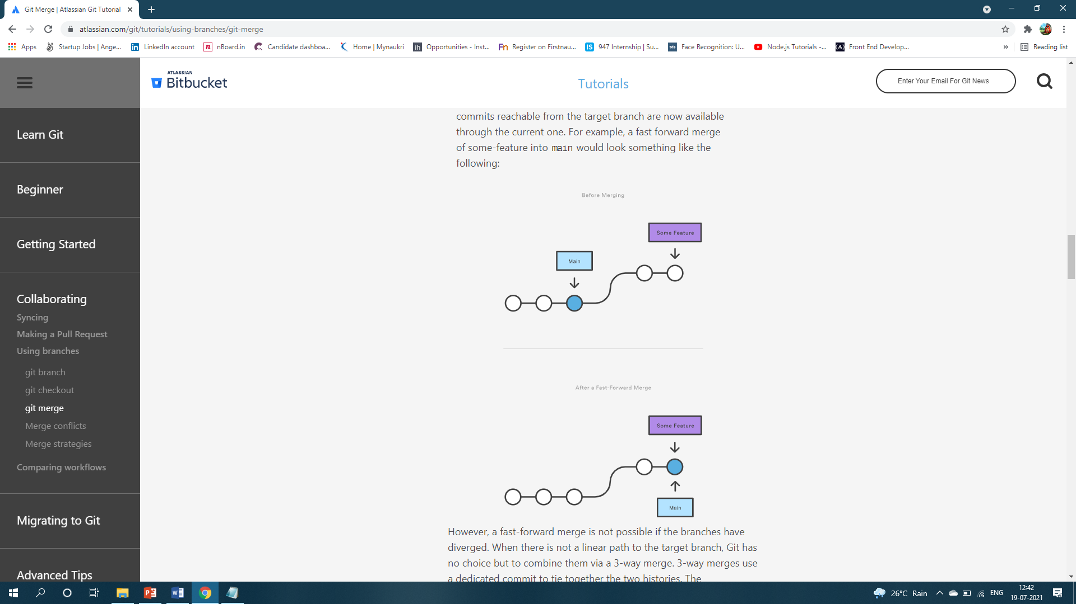
Types of Merging
Fast-Forward Merging:
A fast-forward merge can occur when there is a linear path from the current branch tip to the target branch. Instead of “actually” merging the branches, all Git has to do to integrate the histories is move (i.e., “fast forward”) the current branch tip up to the target branch tip. This effectively combines the histories, since all of the commits reachable from the target branch are now available through the current one.
For example, a fast forward merge of some-feature into main would look something like the following:
#code:
# Start a new feature git checkout -b new-feature main # Edit some files git add <file> git commit -m "Start a feature" # Edit some files git add <file> git commit -m "Finish a feature" # Merge in the new-feature branch git checkout main git merge new-feature git branch -d new-feature
Notes:
7

Slide 8
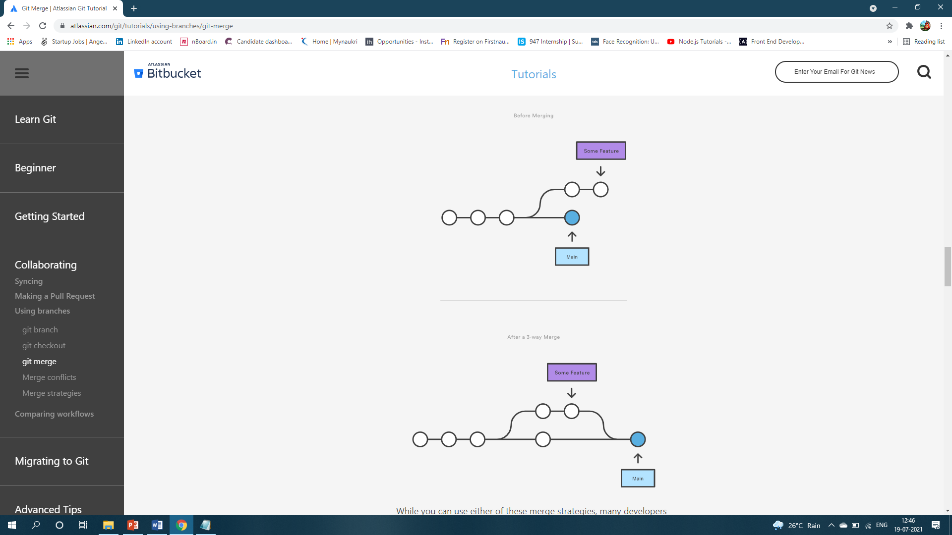
2. 3-Way Merging:
The next example is very similar, but requires a 3-way merge because main progresses while the feature is in-progress. This is a common scenario for large features or when several developers are working on a project simultaneously.
**Note that it’s impossible for Git to perform a fast-forward merge, as there is no way to move main up to new-feature without backtracking.
For most workflows, new-feature would be a much larger feature that took a long time to develop, which would be why new commits would appear on main in the meantime. If your feature branch was actually as small as the one in the above example, you would probably be better off rebasing it onto main and doing a fast-forward merge. This prevents superfluous merge commits from cluttering up the project history.
#Code:
Start a new feature git checkout -b new-feature main # Edit some files git add <file> git commit -m "Start a feature" # Edit some files git add <file> git commit -m "Finish a feature" # Develop the main branch git checkout main # Edit some files git add <file> git commit -m "Make some super-stable changes to main" # Merge in the new-feature branch git merge new-feature git branch -d new-feature
Notes:
8

Slide 9
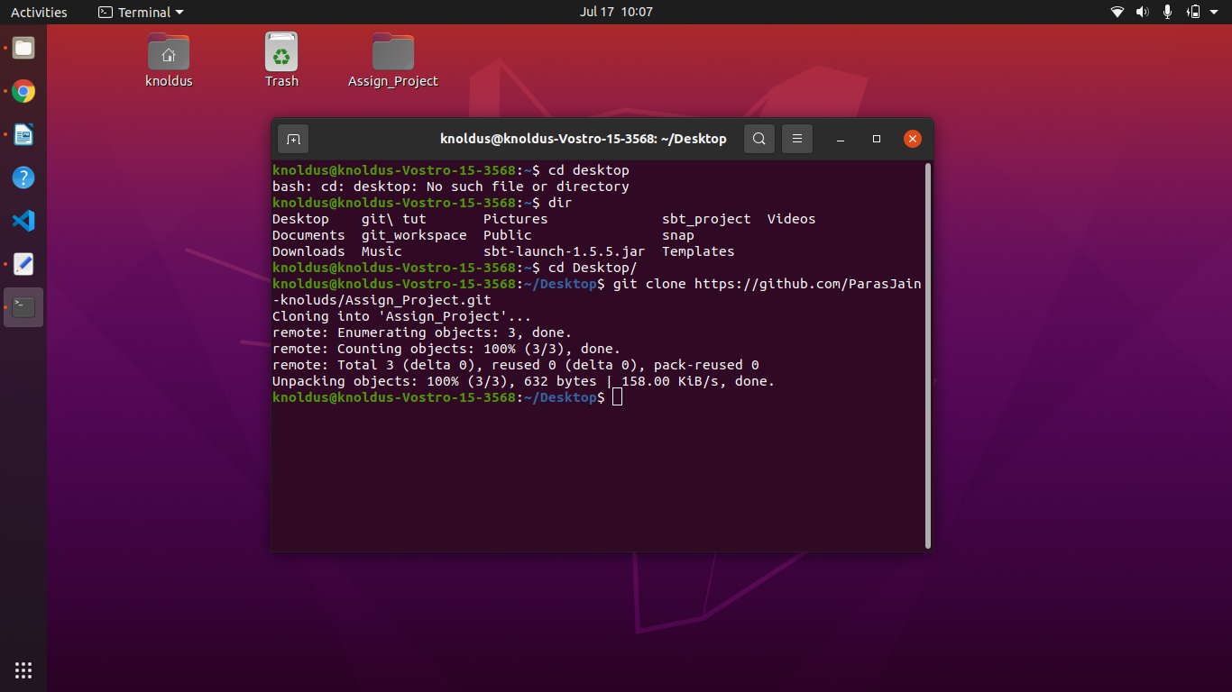
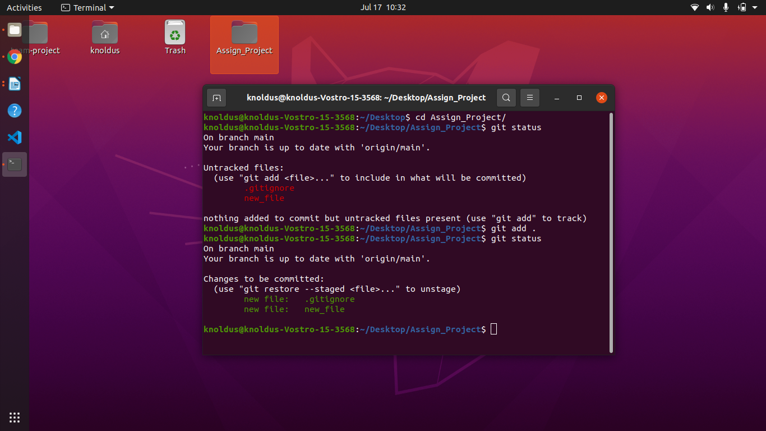
Code
Creating a new repository by cloning it from github and initialized in our local directory.
Image Placeholder
Image Placeholder
Image Placeholder
Adding new files to repository and check the status of the files.
Notes:
9

Slide 10
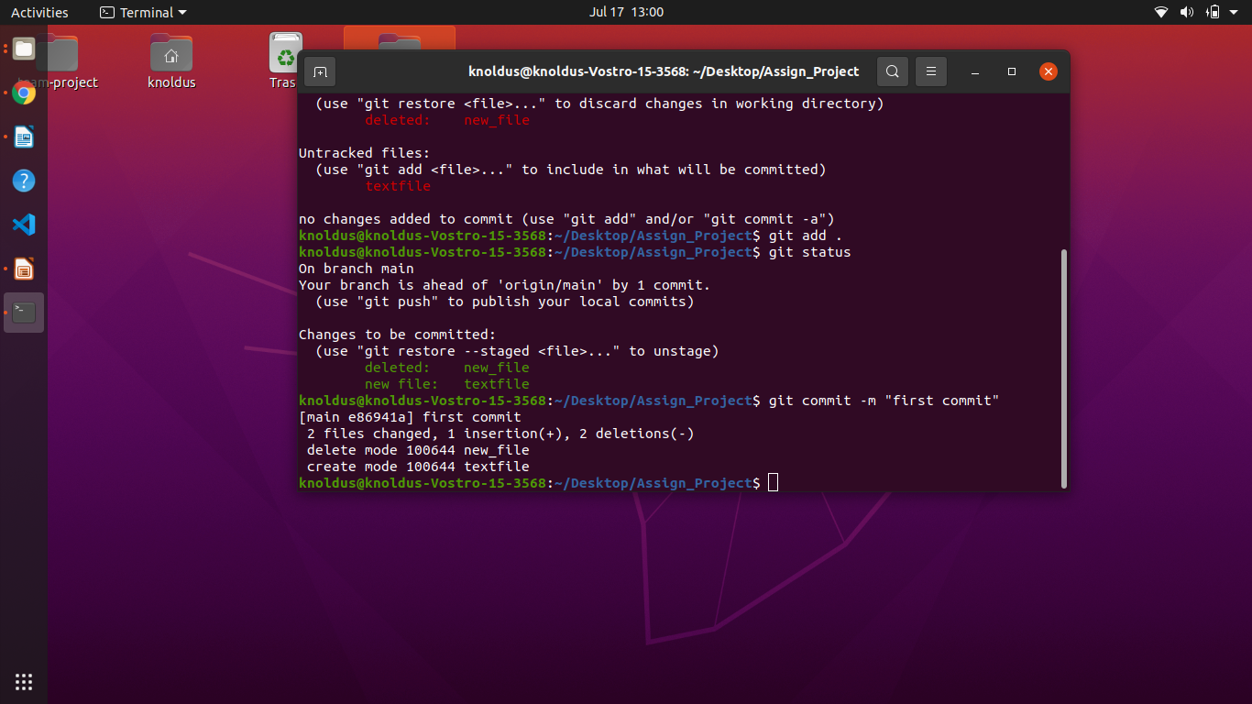
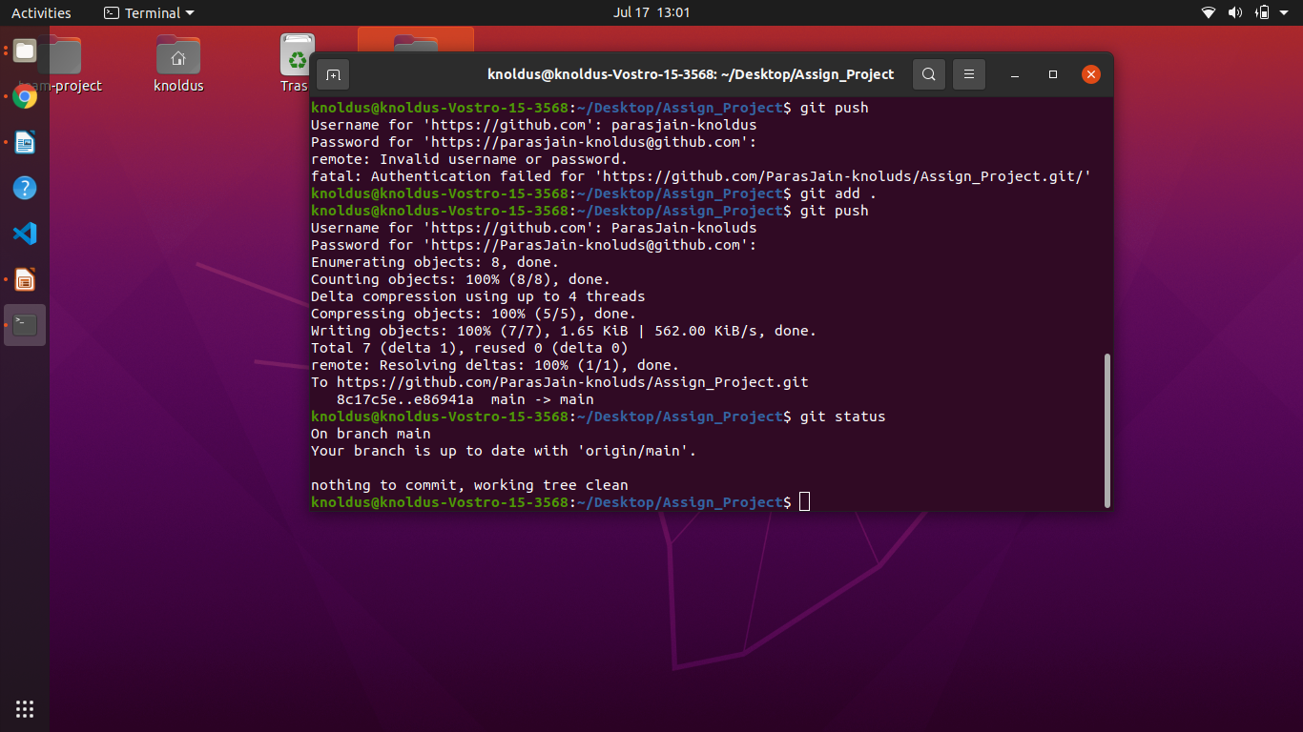
Commit the file added to the repository.
Push the committed file to the global repository.
Notes:
10

Slide 11
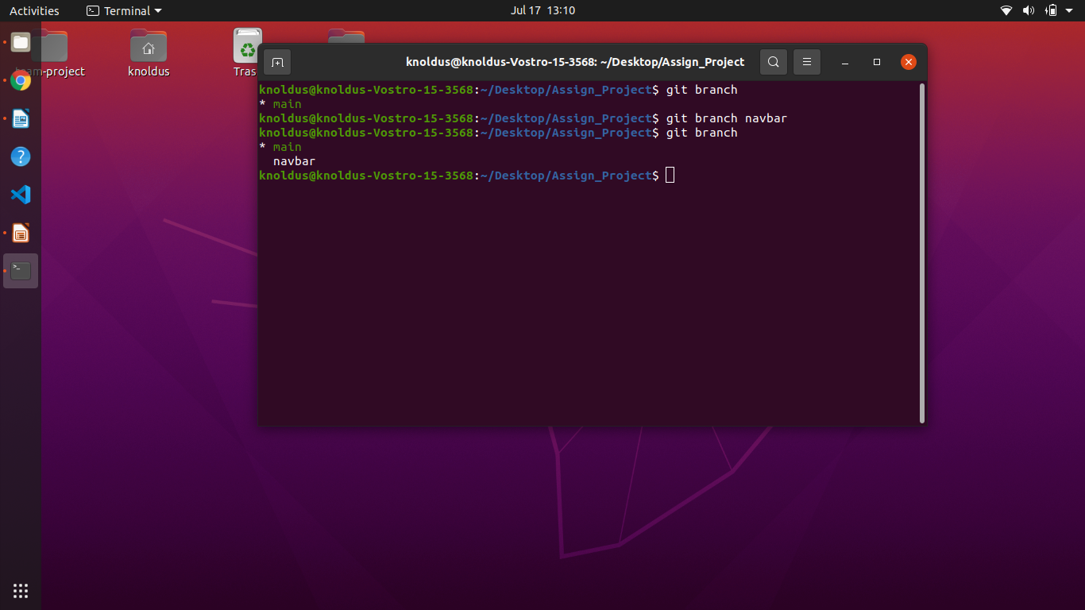
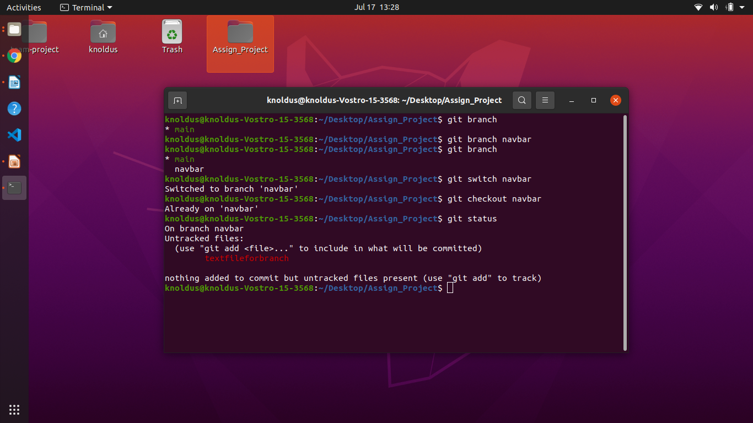
Creating a New branch <navbar> to the repository.
List all the branches.
Image Placeholder
Image Placeholder
Image Placeholder
Adding new file to the navbar branch.
Check the status of the branch.
Notes:
11

Slide 12
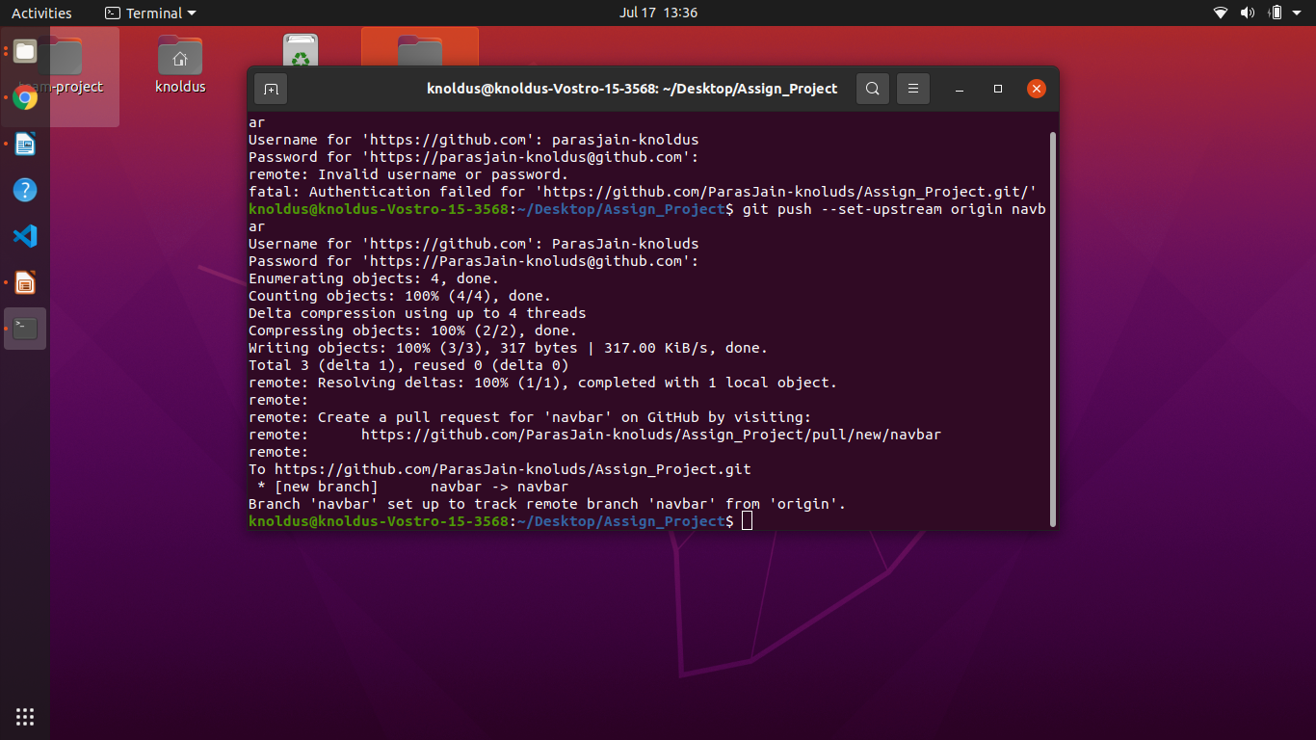
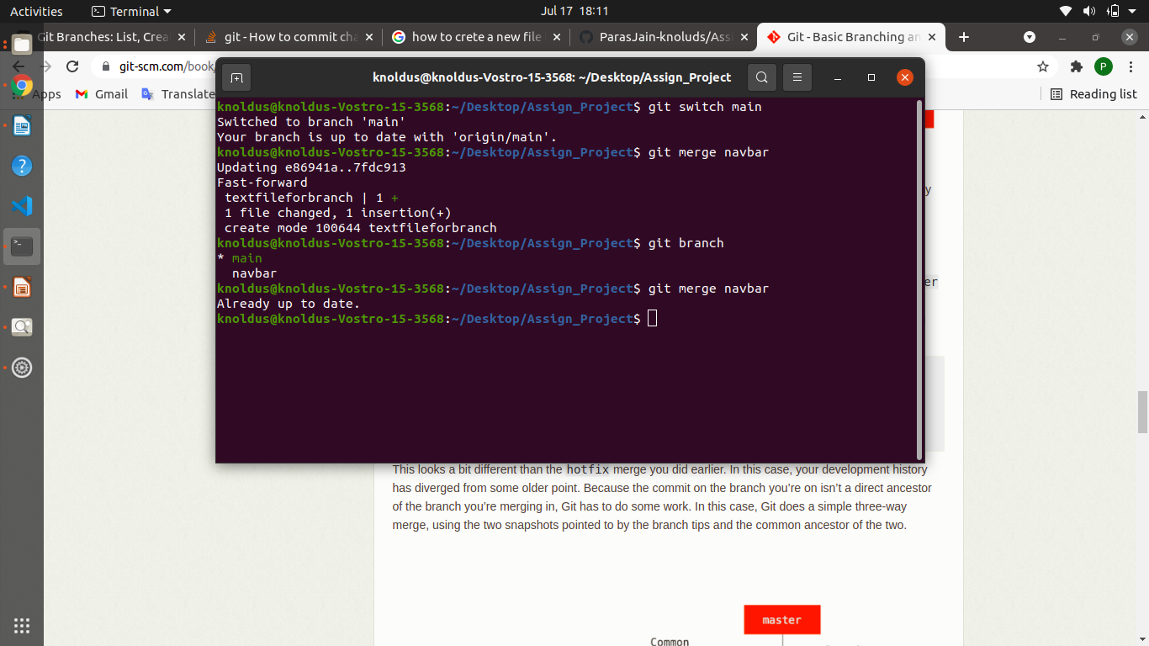
Commit file and Push the file to the navbar branch.
Check the status of working tree.
Merge the branches.
Notes:
12

Slide 13
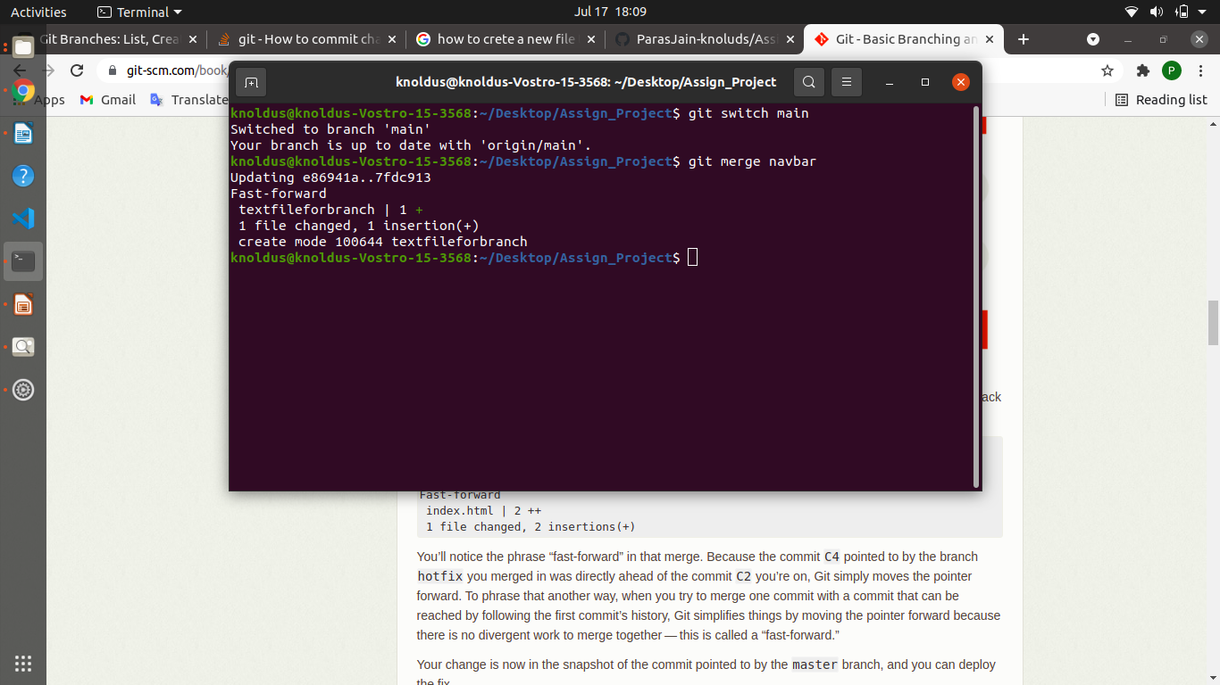
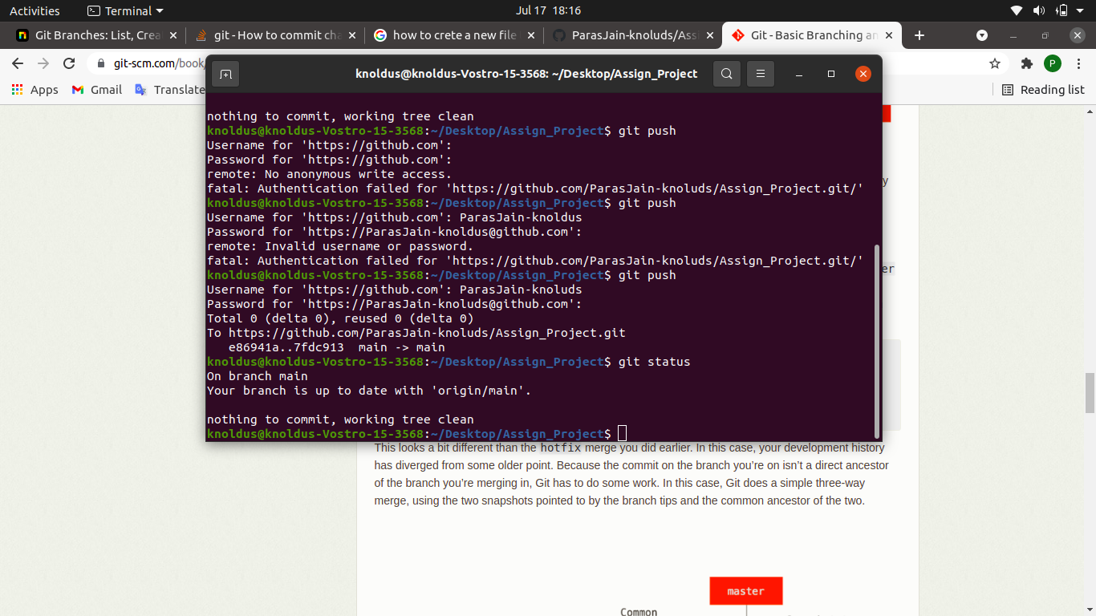
Merge the navbar branch to the main branch.
Check the status of the working tree.
Notes:
13

Slide 14
Importance of Merging
Make a ease while working on a big project.
Merging is Git's way of putting a forked history back together again.
Git merging combines sequences of commits into one unified history of commits.
Git can automatically merge commits unless there are changes that conflict in both commit sequences.

Slide 15
Thank You !
Notes:
15

